Slide 1


Learn to program
Python
William Hartemink, Hazem Hassan
October Something, 2018

Slide 2
Why Learn to Program?

Slide 3
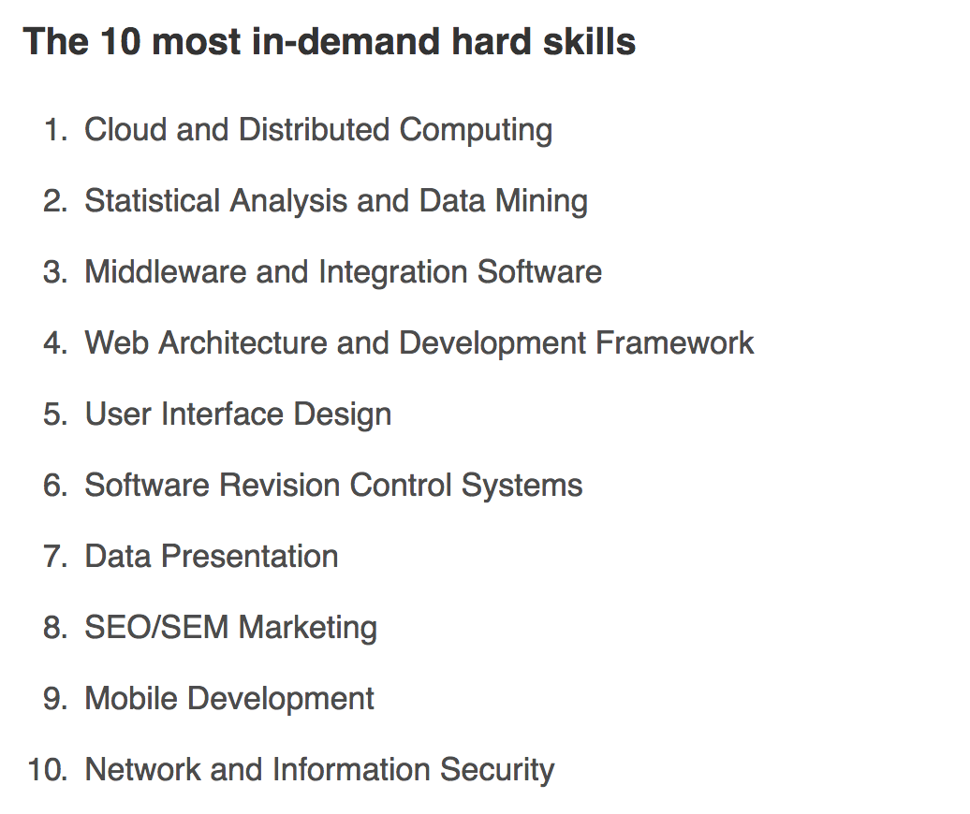


Slide 5
Why Learn to Program?
Skills are in-demand

Slide 6
Programming can be personally useful

Slide 7
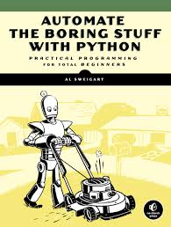
Programming can be personally useful

Slide 8
Stuff that we’ll automate?

Slide 9

Stuff that we’ll automate?

Slide 10


Stuff that we’ll automate?

Slide 11


Stuff that we’ll automate?

Slide 12
Why Learn to Program?
Skills are in-demand
Programming is personally useful

Slide 13
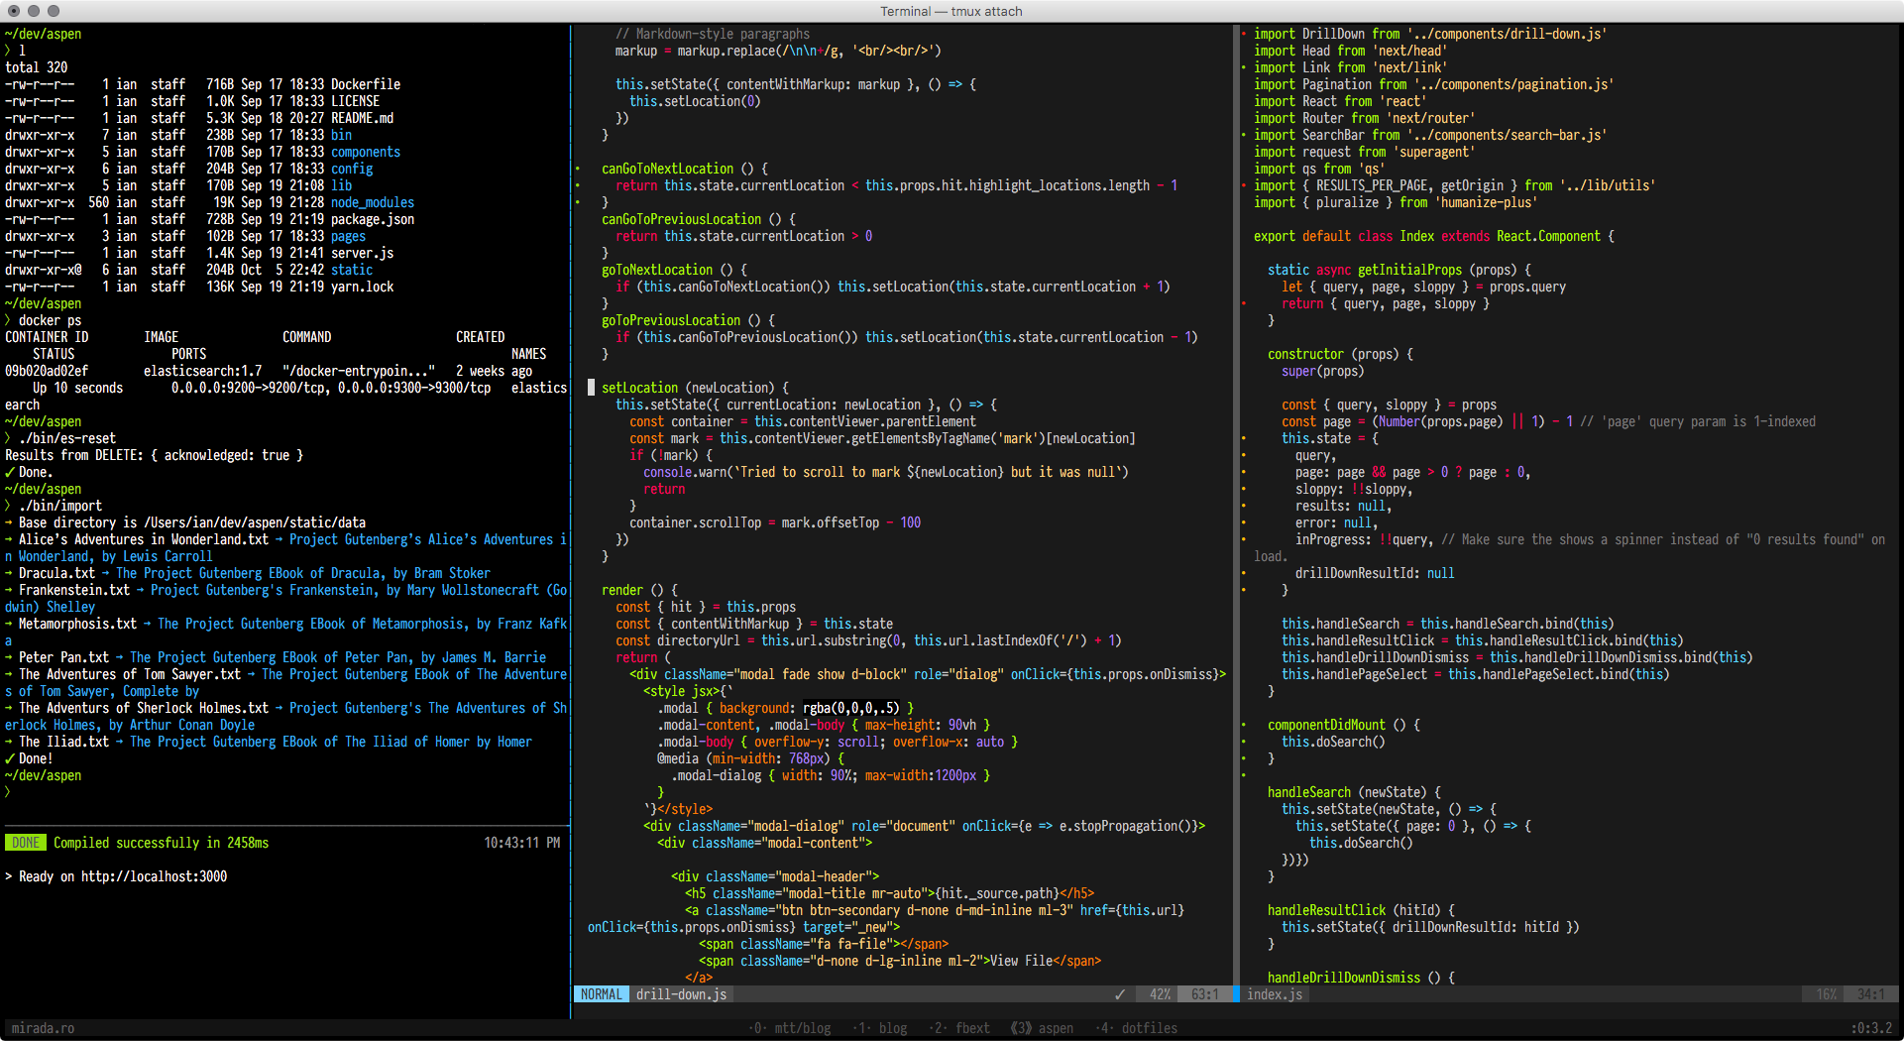
Is it true that you have to start from a very young age?

Slide 14
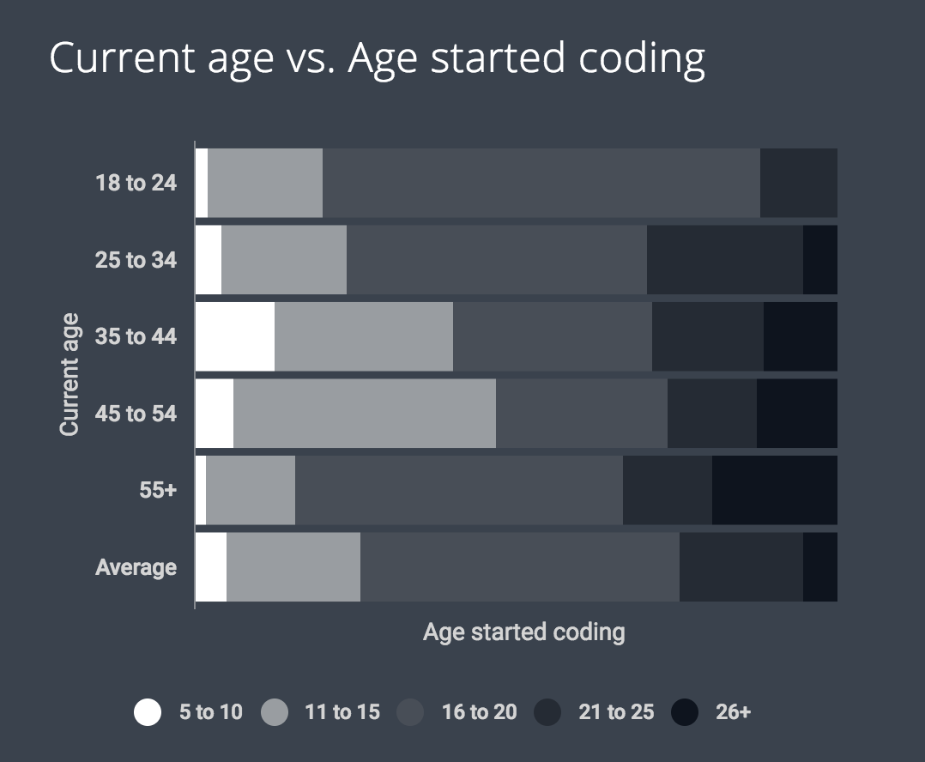

Slide 15
Why Learn to Program?
Skills are in-demand
Programming is personally useful
University age is a great time to start

Slide 16
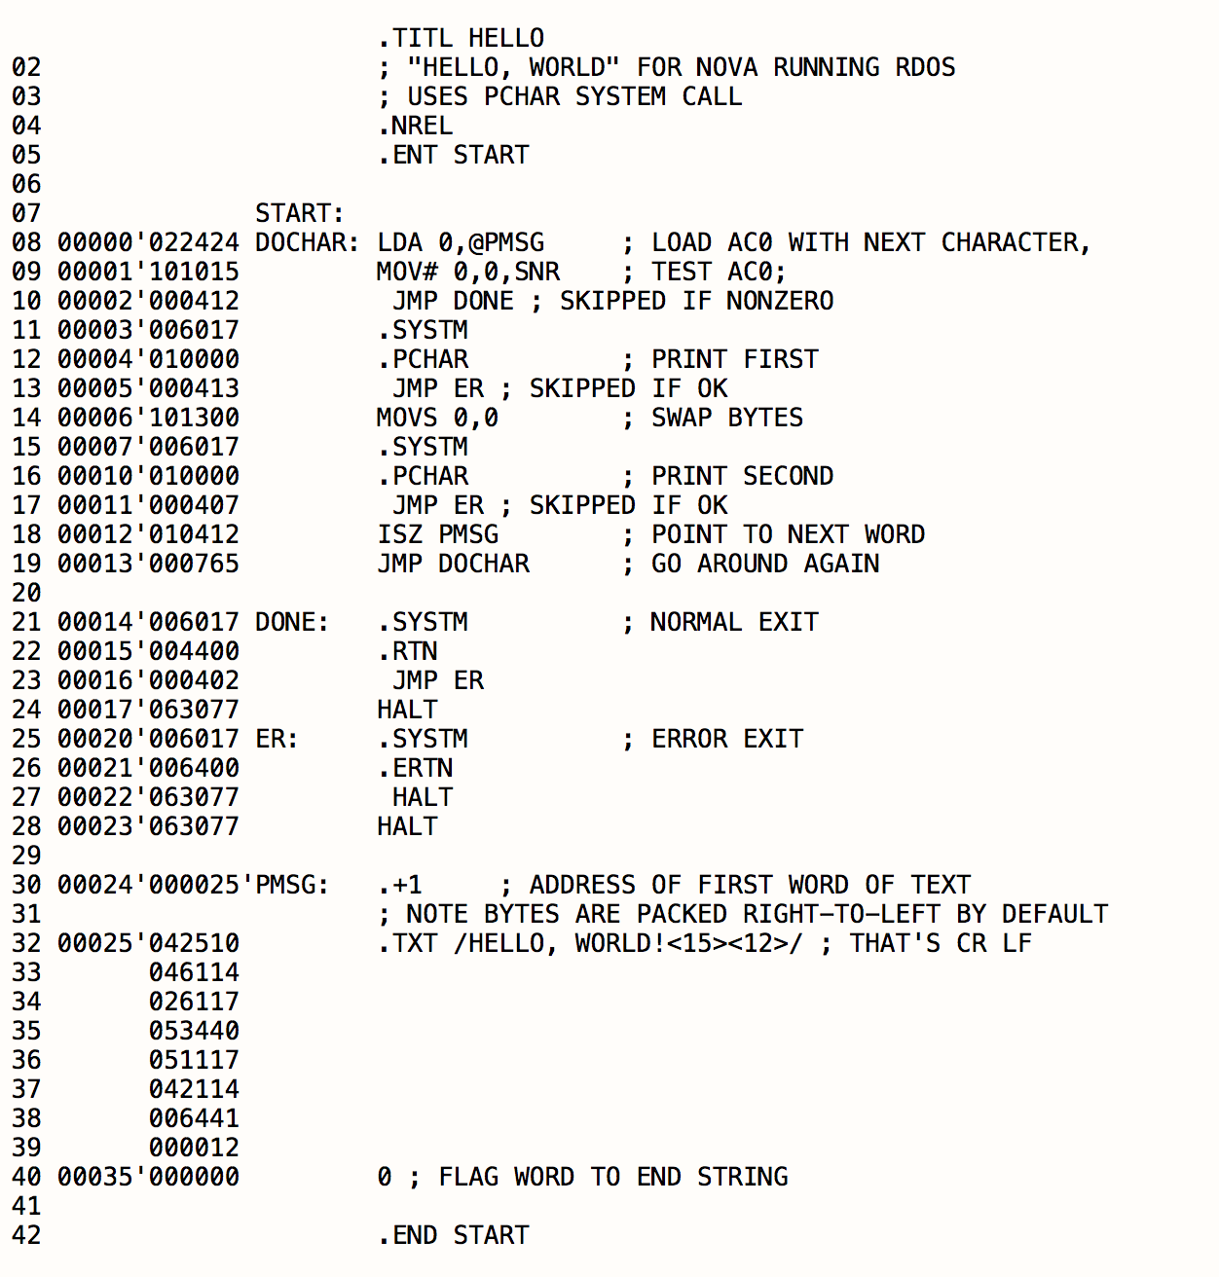
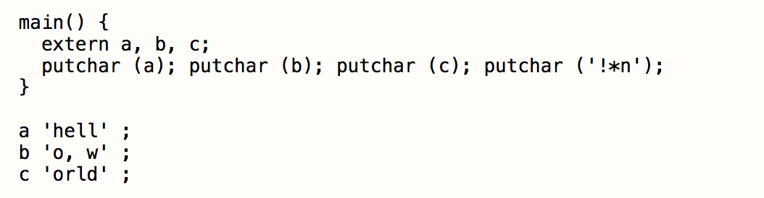
Assembly (invented 1949)
B (invented 1969)

Slide 17
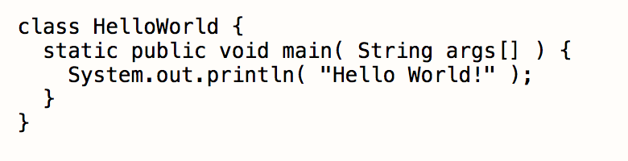
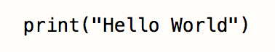
Java (1991)
Python (1990)

Slide 18
Java (1991)
Python (1990)
How is this possible?

Slide 19
print(“hello world”)

Slide 20
print(“hello world”)
Does a whole lot of things

Slide 21
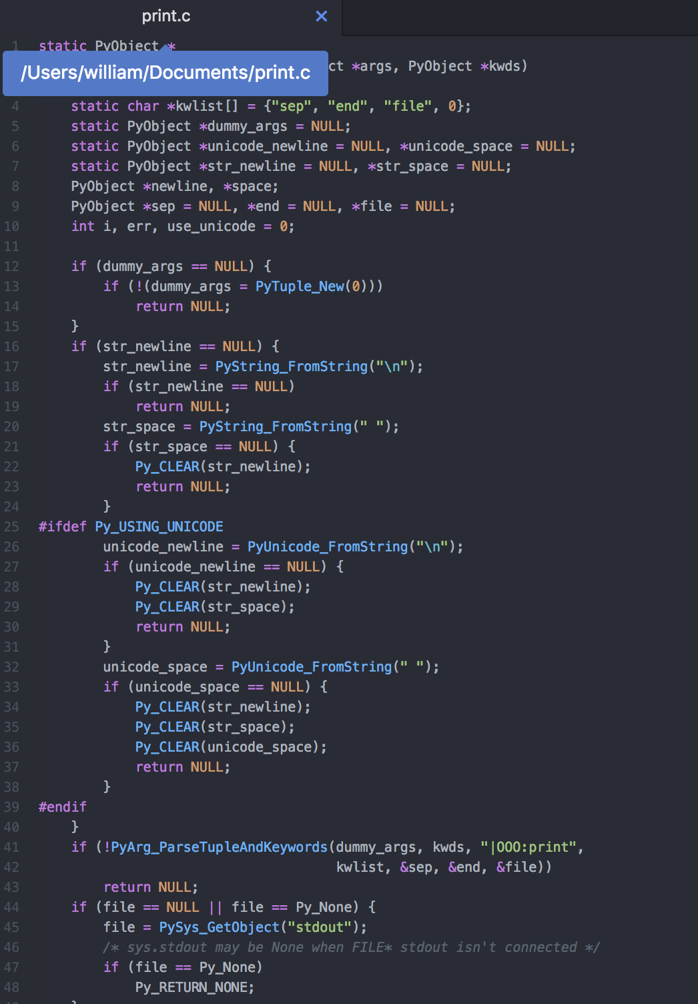
120 lines of code (in C)
print(“hello world”)
Does a whole lot of things
And that doesn’t really matter to us

Slide 22
120 lines of code (in C)
print(“hello world”)
Does a whole lot of things
People are building tools like these every day!

Slide 23
Why Learn to Program?
Skills are in-demand
Programming is personally useful
University age is a great time to start
Programming is more accessible than ever

Slide 24
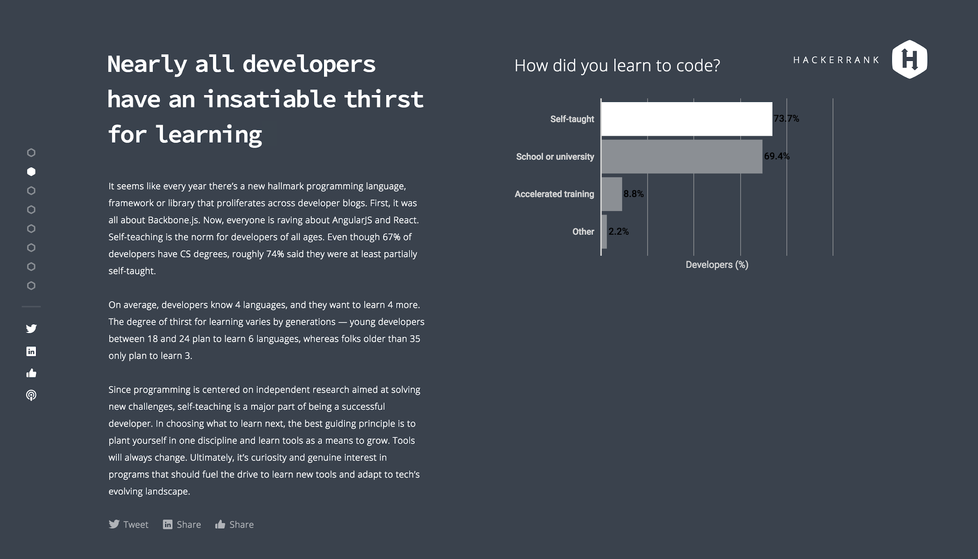

Slide 25
Why Python?

Slide 26
Why Python?
Good First programming language

Slide 27
Why Python?
Good First programming language

Slide 28
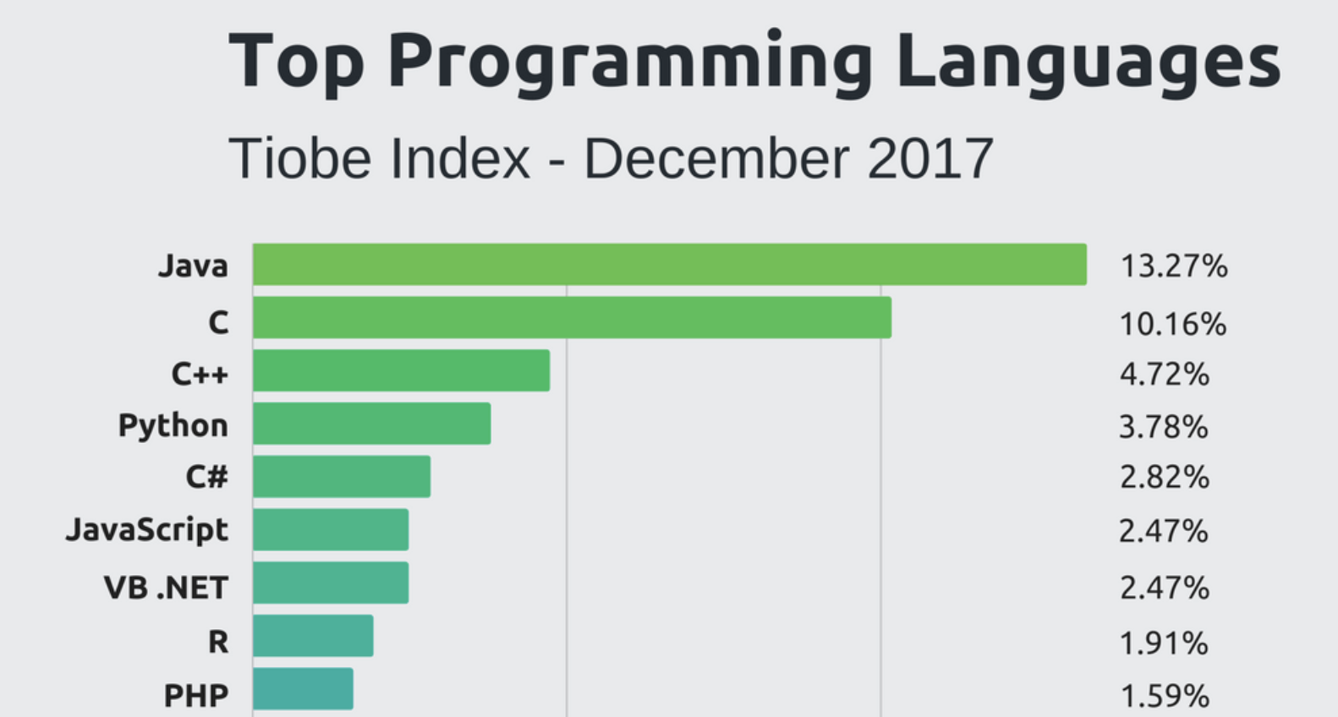
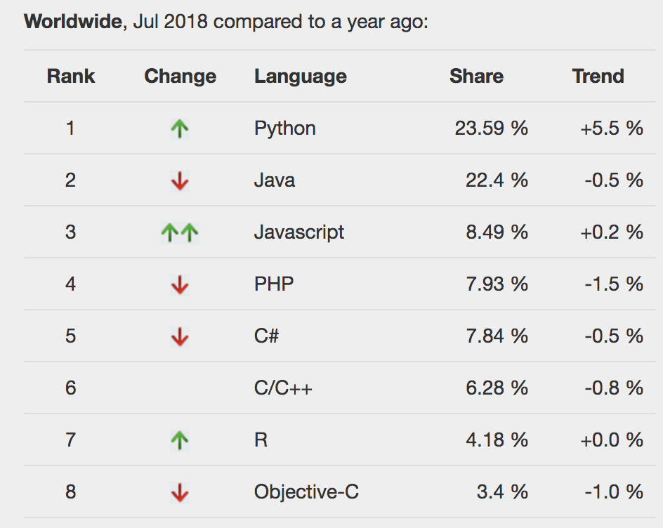
Consistently Popular

Slide 29
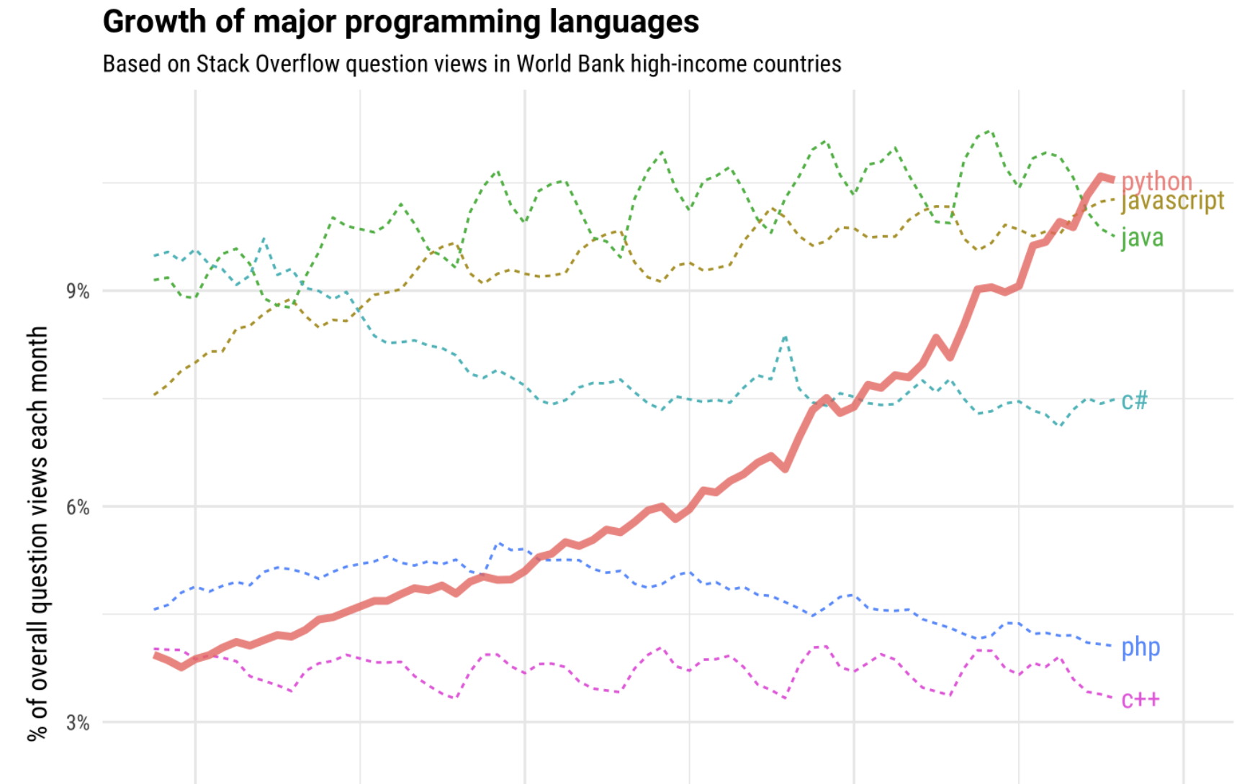
Consistently Popular

Slide 30
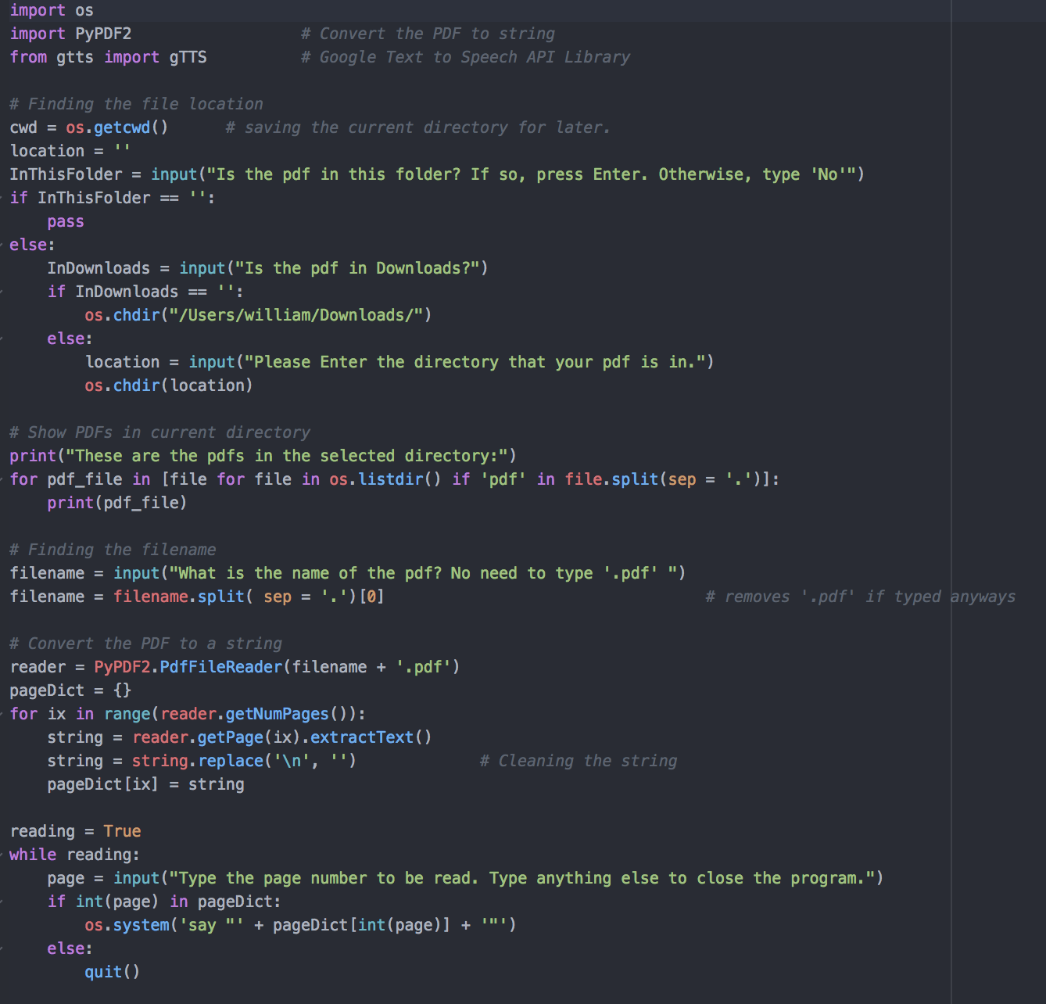
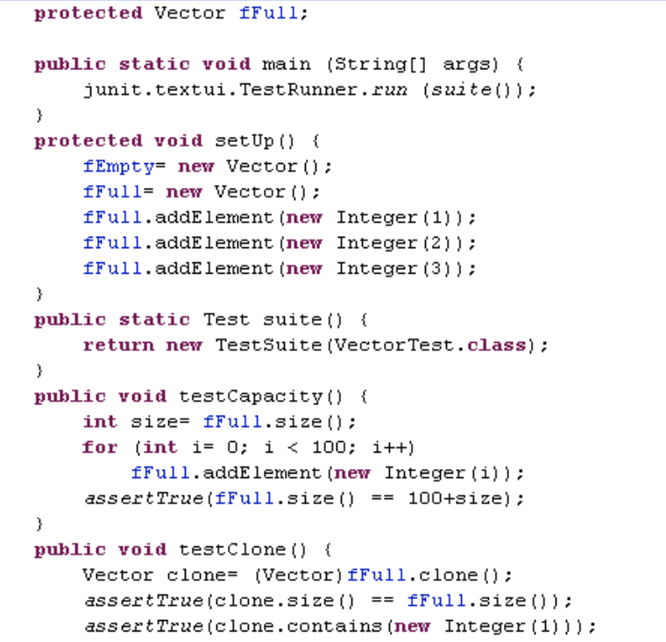
Easy to Read

Slide 31
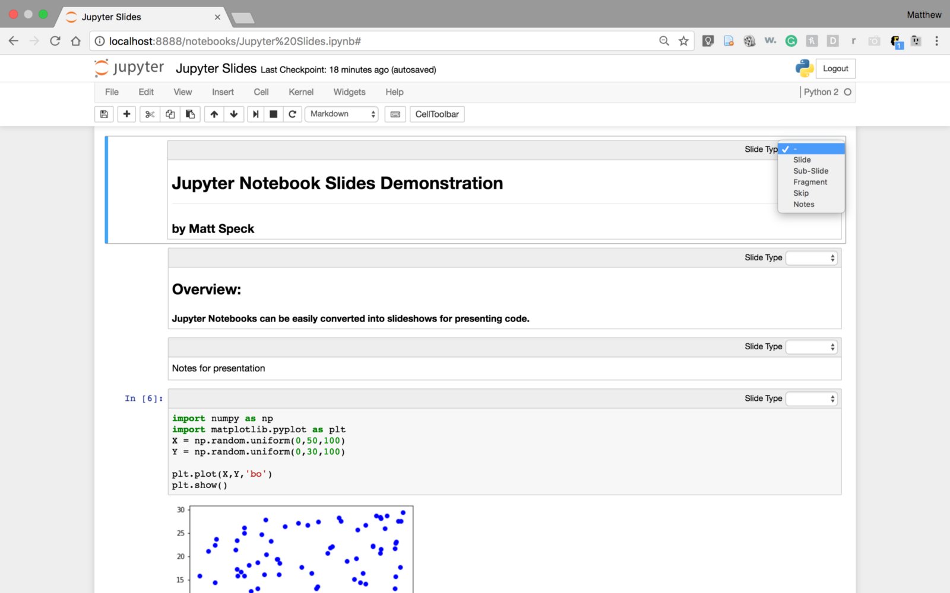
Easy to Write

Slide 32
Loads of tools (libraries, packages)

Slide 33
Loads of tools (libraries, packages)
Open up terminal, and type:
>>>conda list
To see how many you have

Slide 34
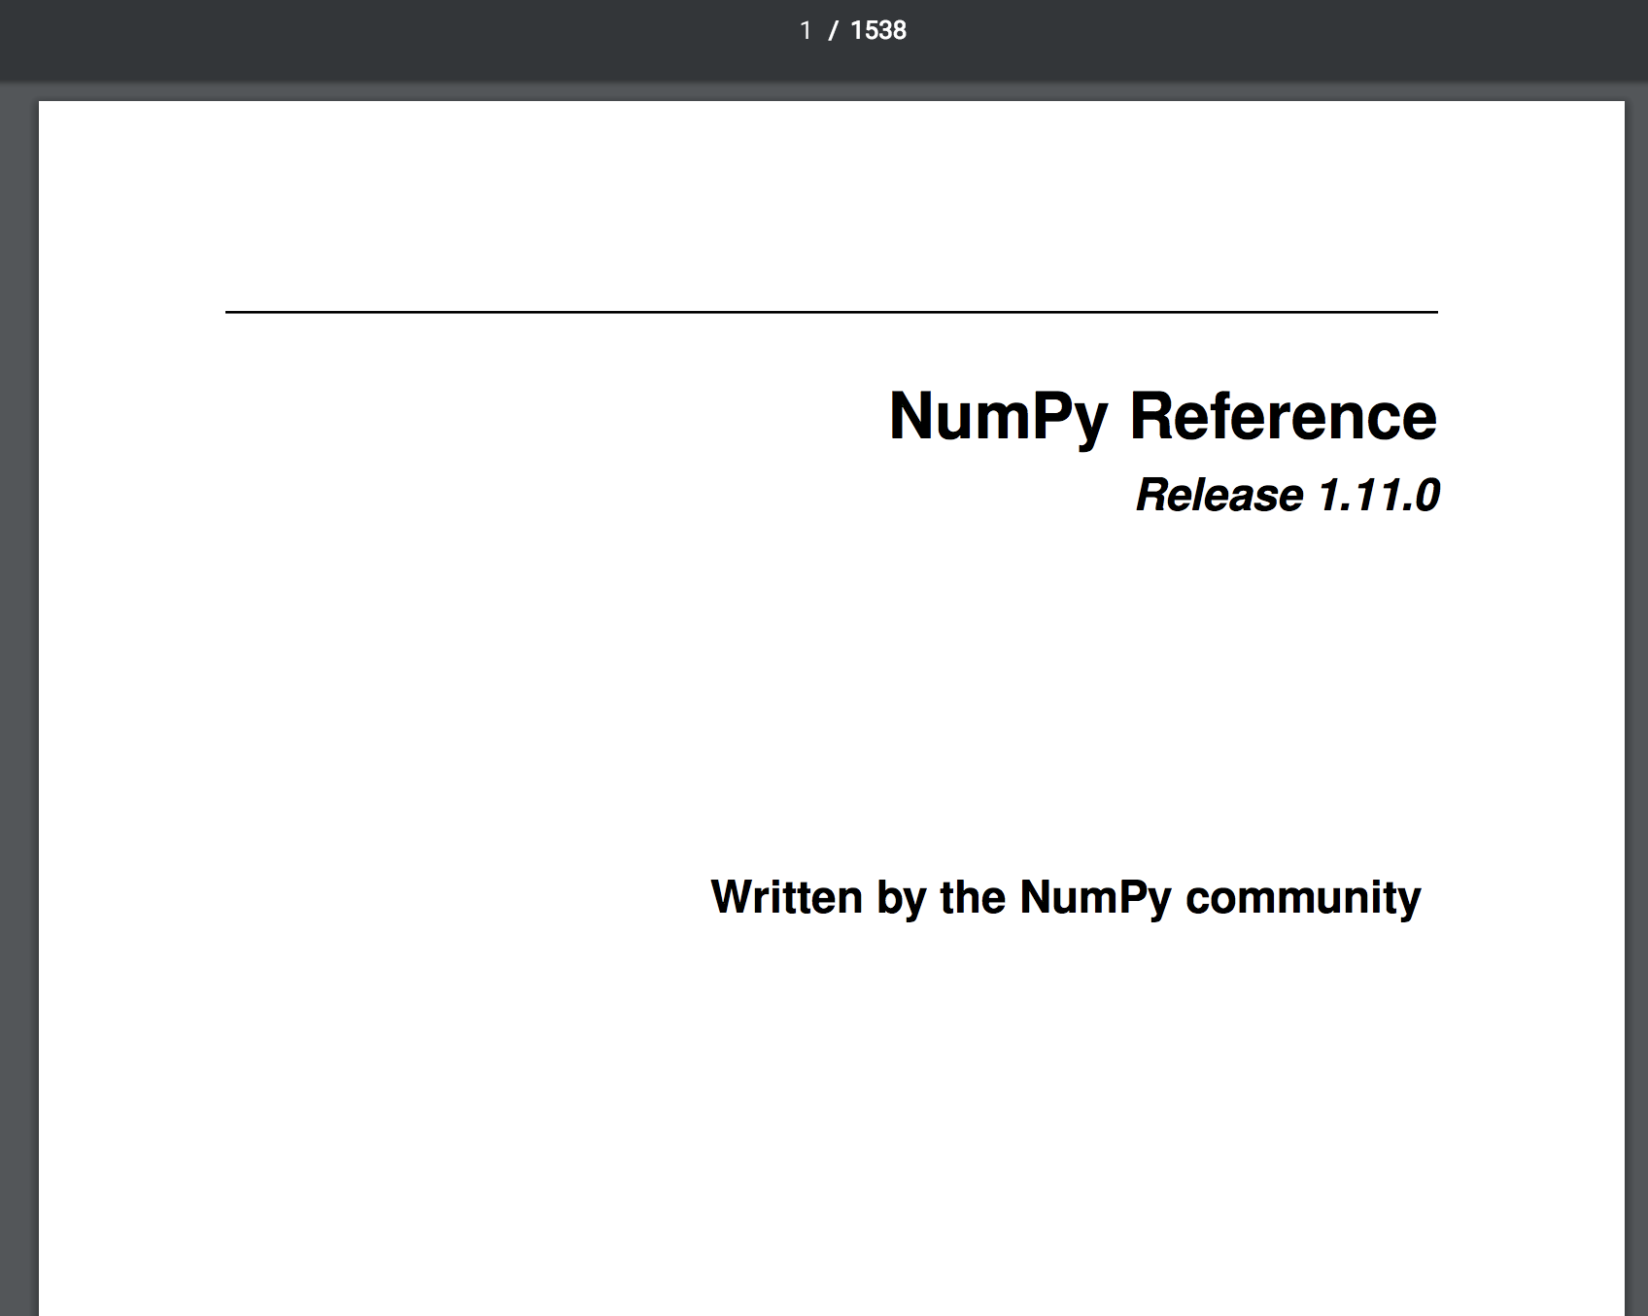

Slide 35


Slide 36
Python is open-source!
It’s free to use, unlike MATLAB

Slide 37
Why Python?
Good First programming language
Easy to Read
Easy to Write
Loads of Tools
Open-Source!

Slide 38
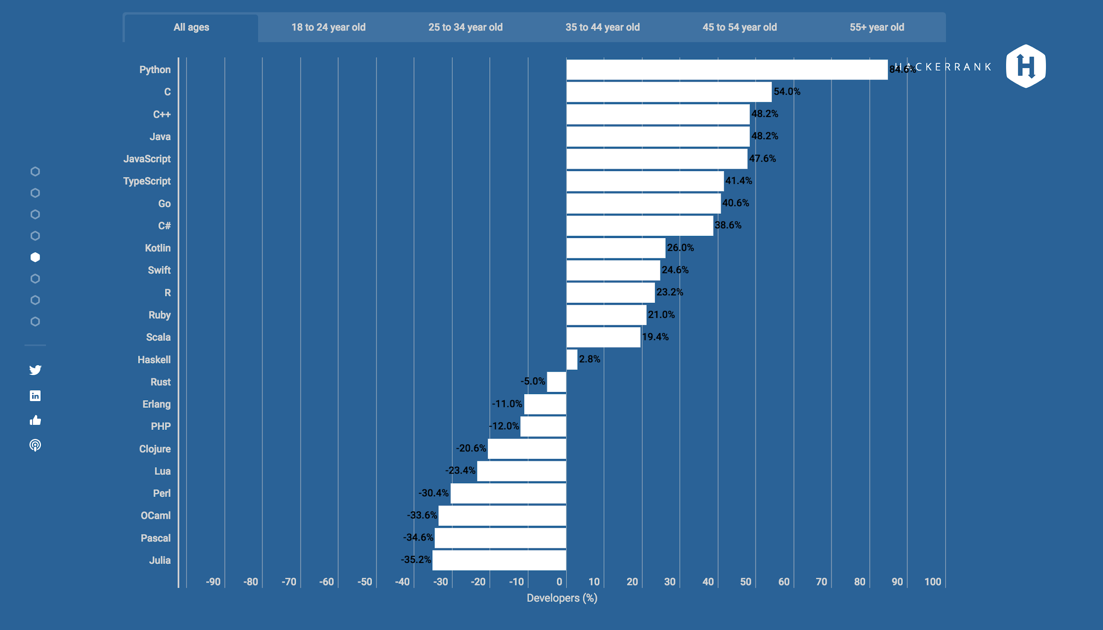
Python is a favorite <3
84.6% approval

Slide 39
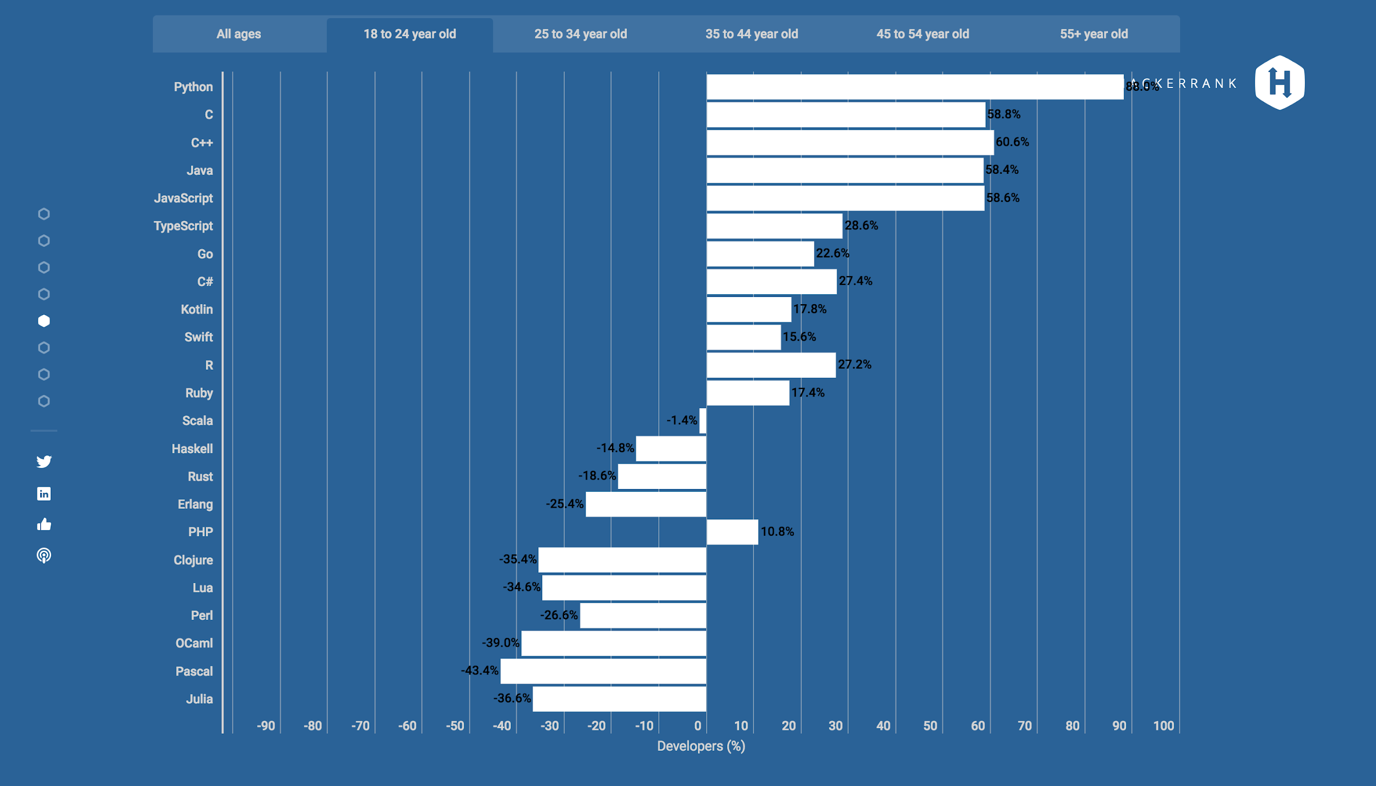
Especially to young people
88.0% approval

Slide 40
Course
Overview

